Slide 1

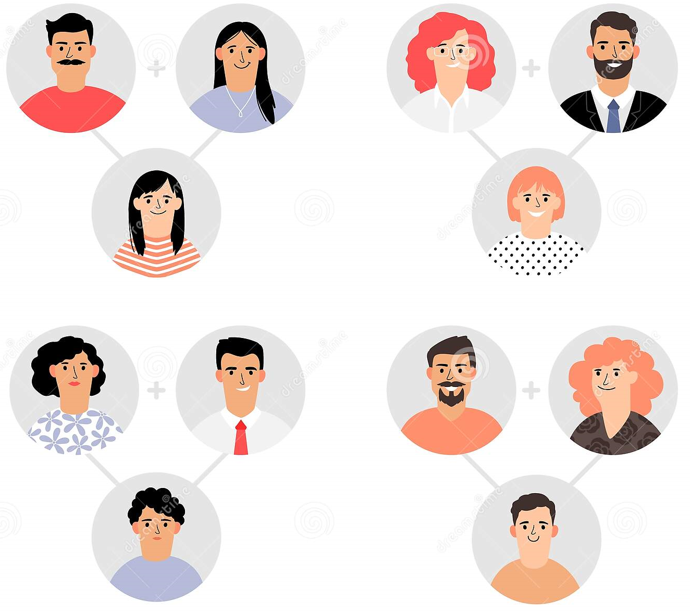
Inheritance

Slide 2
We are learning about simple inheritance
TRACK WITH ME
READ WITH ME
Define allele
Explain the difference between dominant and recessive traits
Distinguish between genotype and phenotype
DECLARE THE OBJECTIVE
Read the learning objective to your partner.
Notes:
Learning Objectives contain concepts (nouns, big ideas), skills (verbs, measurable behaviours) and sometimes context (restricting or targeting conditions).
●Example: Students will be able to describe the concept of density and apply it to floating and sinking.
●
Success criteria are specific measurable outcomes that if met mean that the student has met the learning objective.
Examples:
•Students will be able to compare densities of substances using mass and volume.
•Students will be able to identify whether a solid or liquid will float or sink in a liquid based on their densities.

Slide 3
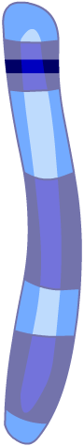
Genetics and Inheritance
Genetics is the study of characteristics called traits. In natural populations all the individuals have different traits. However, some patterns of inheritance of traits can be identified.
Variations of genes are known as alleles.
Alleles occupy the same position on homologous chromosomes.
One pattern of inheritance can be illustrated using human eye colour. Each chromosome in the pair however, may have a different version of the gene.
allele for
Brown eyes
allele for
Blue eyes

Slide 4
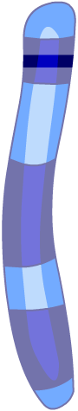
Inheritance
For example, the version of a gene on one chromosome may code for brown eyes, whereas the version of the gene on the other chromosome may code for blue eyes or even green eyes.
HOMOZYGOUS ALLELES:
If the alleles for a characteristic in a homologous pair are the same, the organism is said to be homozygous for that characteristic.
What colour eyes will these homozygous
pairs of alleles produce? >>
allele for brown eyes
allele for brown eyes
allele for blue eyes
allele for blue eyes

Slide 5
Inheritance
HETEROZYGOUS ALLELES:
If the alleles for a characteristic in a homologous pair are different, the organism is said to be heterozygous for that characteristic.
What colour eyes will this heterozygous pairs of alleles produce?
The characteristic expressed by heterozygous alleles will depend on which allele is dominant and which allele is recessive.
allele for brown eyes
allele for blue eyes

Slide 6
DOMINANT OR RECESSIVE
A Genotype is the genetic makeup representation of an individual.
A Phenotype is the actual physical representation of an individual.
The Phenotype of a particular characteristic depends on which allele is dominant and which allele is recessive.
Dominant alleles are always expressed in a cells phenotype. Only one copy of the dominant allele need to be inherited for it to be expressed. Domant alleles (e.g. brown eyes) are represented by an upper case letter (B)
Recessive alleles are only expressed in a cell’s phenotype if two copies of it are present. If only one copy is present, its effect is “masked” by the dominant allele. Recessive alleles (e.g. blue eyes) are represented by a lower case letter (b)

Slide 7
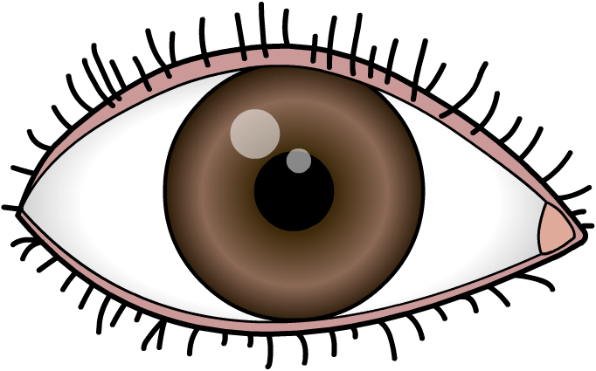
What eye colour?
The allele for brown eyes is dominant over the allele for blue eyes.
So, what colour will the eyes be for an individual who is heterozygous for eye colour?
allele for brown eyes
allele for blue eyes
The individual will have brown eyes, because the allele for brown eyes masks the allele for blue eyes.

Slide 8
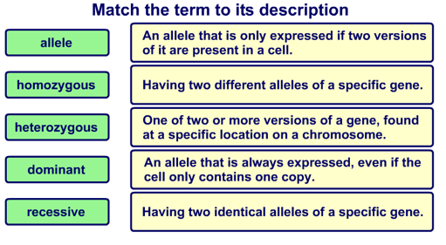
Inheritance terms

Slide 9
Homozygous cross
The eye colour in the offspring of homozygous parents.
Remember: the allele for Brown (B) is dominant over the allele for Blue (b) eyes.
If a homozygous brown-eyed person and a homozygous blue-eyed person reproduce, what are the possible eye colour of their offspring?
How did you work it out?
What if we wanted to know all the possible eye colours their offspring could have?

Slide 10
Punnett Squares
A Punnett square is one way of showing all the possible types of offspring that could result from a cross.
You can’t assume that the offspring will appear in exactly that order and in its exact ratio but is gives us a probability of what could happen.
In a Punnet square, the possible gametes produced by one parent are shown across the top. And the gametes from the other parent are shown down the side.
In each square between them, is the possible outcome of fertilisation.

Slide 11
Punnett Squares
Lets try using punnet squares for a couple of questions.
1. Same as the last one we just did, what could be the outcomes of a homozygous parent with brown eyes (B) and a homozygous parent with blue eyes (b).
2. What would be the outcomes if two heterozygous brown eyed parents reproduce?
3. What would be the outcome if a heterozygous brown-eyed parent and a homozygous blue-eyed parent to reproduce?

Slide 12
Definitions:
Allele
Homozygous
Heterozygous
Genotype
different forms of the same gene at the same point on homologous chromosomes
Having two identical alleles on homologous chromosomes
Having two different alleles on homologous chromosomes
Genetic information carried by an individual. The genetic makeup representation

Slide 13
Definitions:
Phenotype
Dominant
Recessive
Punnett Squares
Observable (physical) characteristics of an individual. The way a genotype is expressed
The trait that is expressed in a heterozygous individual’s phenotype. It only needs one copy to be expressed. Represented by a capital letter (e.g. B)
The trait that is hidden in heterozygous individuals. It needs two copies to be expressed. Represented by a lower case letter (e.g. b)
Are one way of showing all the possible types of offspring that could result from a cross.

Slide 14
Lettering
When looking at the traits of the same allele, the same letter MUST be used.
This is because different letters are used for different alleles.
For example, if we look at the fur colour of mice, brown fur is dominant to white fur.
Therefore, the dominant brown fur would be B, and the recessive white fur would be b.

Slide 15
Finding the genotype
For some characteristics, the genotype of a homozygous recessive individual can be determined from their phenotype.
For example, the allele for brown fur (B) in mice is dominant over the allele for white fur (b). This means that all white mice must therefore have the genotype (bb).
But what about individuals that have brown fur?
Is their genotype BB or Bb?
A test cross can be used to determine whether an individual is homozygous or heterozygous for a dominant trait.
A test cross (with animals) is conducted by breeding the unknown with a recessive homozygous animal.

Slide 16
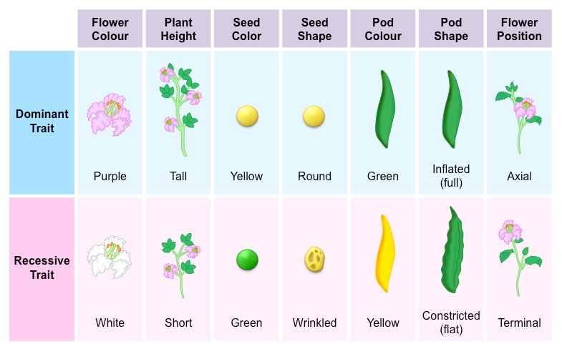
Gregor Mendel
Gregor Mendel (1822-1884) was an Austrian monk who solved the fundament problems in understanding genetics with his research on the garden pea.
It is through his research and cross breeding of the above seven traits that we understand what we do about dominant and recessive genetic traits today.
This type of genetics and heredity is known as Mendelian Inheritance.

Slide 17
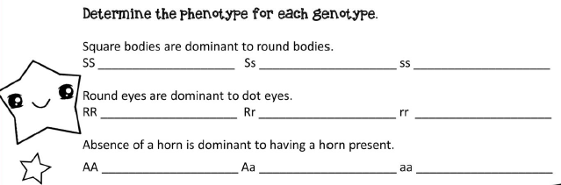
Inheritance practice – Kawaii Genetics
Introduction: The creature of the Island Kawaii are the world’s cutest species of animals. Let’s take a closer look to see how combinations of genes are creating the cutest species on the planet!
Write you own short-hand to remember these phenotypes

Slide 18
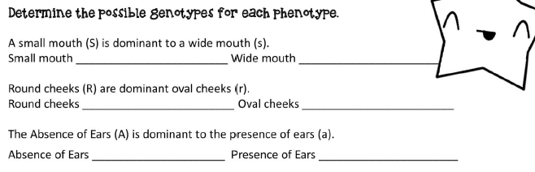
Inheritance practice – Kawaii Genetics
Write you own short-hand to remember these genotypes

Slide 19
Inheritance practice – Kawaii Genetics
Use the genotypes and phenotypes provided to create Punnett squares and determine the possible genotypes, phenotypes and % chance of each characteristic for the following questions:
Tsumi is a square kawaii creature (Ss). Lunu is a round kawaii creature (ss). What are the possible offspring that Tsumi and Lunu could produce.
JoJo has the largest homozygous dominant round eyes on Kawaii island, while Gobi has the smallest homozygous recessive dot eyes. What are the possible offspring that Jojo and Gobi could produce.
Ears are a recessive trait in Kawaii. Mofu has ears and GoGo is heterozygous for ears and does not have them. What are the possible offspring that Mofu and GoGo could produce.

Slide 20
Inheritance practice – Kawaii Genetics continued…
4. A small mouth can make the cutest smile. Loofa and Dodine are heterozygous for small mouths. What are the possible offspring for Loofa and Dodine?
5. Horns in Kawaii are unique and prized. Mofu and Riru both have horns. What are the possible offspring for Mofu and Riru could produce?
6. Is it possible for two kawaii creatures without horns to have offspring with the prized horn? Justify your answer.

Slide 21
Dihybrid crosses (2 traits)

Slide 22
Dihybrid crosses
Di-hybrid crosses are use when we want to track two traits at once.
Remember each gamete will contain one allele for each trait.
Which means the possible combinations of alleles that we place in the Punnett squares will always have one letter for each trait.

Slide 23
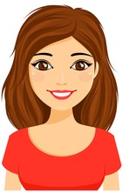
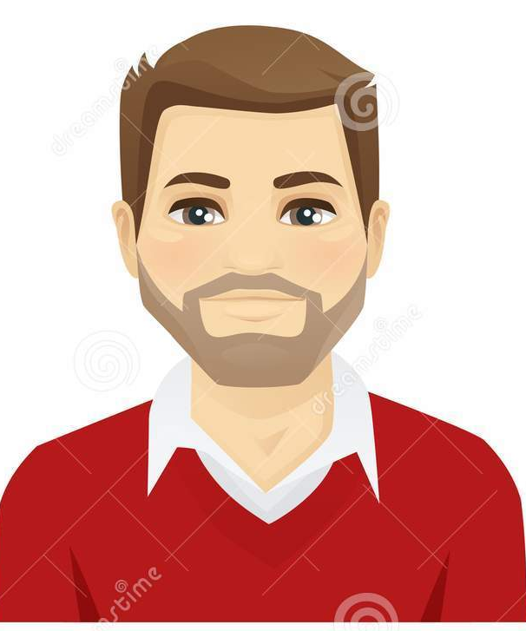
Dihybrid crosses
In a dihybrid cross, both animals are heterozygous for two traits.
In this example, both parents have Brown hair
AaBb x AaBb

Slide 24
Dihybrid crosses
Again we want to know the probability of what hair colour to expect.
Each parent (AaBb) will donate either an A or an a allele and either a B or b allele.
So every gamete will always contain
ONE A (or a) and one B (or b)

Slide 25
Dihybrid crosses - FOIL
We can use the FOIL method to be sure that we have ALL the possible combinations of alleles.
First
Outer
Inner
Last

Slide 26
Dihybrid crosses - FOIL
AaBb x AaBb
Parent 1:
First: AB
Outer: Ab
Inner: aB
Last: ab
Parent 2:
First: AB
Outer: Ab
Inner: aB
Last: ab
AB
Ab
aB
ab
AB
Ab
aB
ab

Slide 27
Dihybrid crosses - FOIL
Once we’ve labelled our parents, we fill in the squares.
REMEMBER:
Put alleles for one gene together
Aabb not Abab
Dominant alleles before recessive
AaBb not aAbB

Slide 28
Dihybrid crosses - FOIL
AaBb x AaBb
Let’s do the first row
together
It should look like…
Complete the remaining
rows on your own.
They should look like…
 | AaBb | AAbb | AaBb | Aabb
 | AaBB | AaBb | aaBB | aaBb
 | AaBb | Aabb | aaBb | aabb
 | AB | Ab | aB | ab
AB
Ab
aB
ab
 | AABB | AABb | AaBB | AaBb

Slide 29
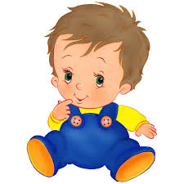
Dihybrid crosses - FOIL
AaBb x AaBb
The phenotypes would be:
3 Black hair (AABB or AABb)
6 Brown hair (AaBB or AaBb)
1 Red Hair (AAbb)
1 Dark Blonde (aaBB)
4 Blonde (Aabb, aaBb)
1 Light Blonde (aabb)
 | AB | Ab | aB | ab
AB | AABB | AABb | AaBB | AaBb
Ab | AABb | AAbb | AaBb | Aabb
aB | AaBB | AaBb | aaBB | aaBb
ab | AaBb | Aabb | aaBb | aabb
Therefore, the most likely hair colour is…
And the probability ratio is:
3:6:1:1:4:1

Slide 30


Dihybrid crosses – Eye Colour
In a dihybrid cross, both animals are heterozygous for two traits.
In this example, next example, we’re looking at one parent with Hazel eyes (AaBB) and one parent with Dark blue eyes (aaBb)

Slide 31
Dihybrid crosses – Eye Colour
 | AaBB | AaBB | aaBB | aaBB
 | AaBb | AaBb | aaBb | aaBb
 | AaBB | AaBB | aaBB | aaBB
 | AaBb | AaBb | aaBb | aaBb
 | AB | AB | aB | aB
aB
ab
aB
ab
AaBB x aaBb
Parent 1:
First
Outer
Inner
Last
Parent 2:
First
Outer
Inner
Last
AB
AB
aB
aB
aB
ab
aB
ab

Slide 32
Dihybrid crosses – Eye Colour
 | AaBB | AaBB | aaBB | aaBB
 | AaBb | AaBb | aaBb | aaBb
 | AaBB | AaBB | aaBB | aaBB
 | AaBb | AaBb | aaBb | aaBb
 | AB | AB | aB | aB
aB
ab
aB
ab
AaBB x aaBb
Possible Genotypes:
4 Brown (Aabb or AaBb)
4 Hazel (AaBB)
4 Green (aaBB)
4 Dark Blue (aaBb)
This means that the most probable eye colour will be?
What is the ratio for the colours?
All of them!
4:4:4:4

Slide 33
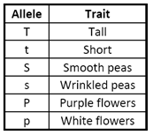
Dihybrid crosses – Practice
Complete the Punnett Squares for each cross,
then answer the following questions using the
information in the table.
Sspp x ssPp
How many combinations of phenotypes will there be?
What percentage of offspring will have smooth peas?
What percentage of offspring will be heterozygous for both pea shape and flower colour?
Ttss x TtSs
How many combination of genotypes will there be?
What percentage of offspring will be tall?
What percentage of offspring will be both short and have wrinkled peas?

Slide 34
Contrast
Contrast the following terms:
Homozygous and Heterozygous
Phenotype and Genotype
Autosome and sex-chromosome
Mendelian (autosomal) inheritance and sex-linked inheritance

Slide 35
Sex-linked Inheritance

Slide 36
We are learning about sex-linked inheritance
TRACK WITH ME
READ WITH ME
Recall genetics terminology & symbols
Explain the difference between autosomal and sex-linked inheritance
Determine offspring with sex-linked traits.
DECLARE THE OBJECTIVE
Read the learning objective to your partner.
Notes:
Learning Objectives contain concepts (nouns, big ideas), skills (verbs, measurable behaviours) and sometimes context (restricting or targeting conditions).
●Example: Students will be able to describe the concept of density and apply it to floating and sinking.
●
Success criteria are specific measurable outcomes that if met mean that the student has met the learning objective.
Examples:
•Students will be able to compare densities of substances using mass and volume.
•Students will be able to identify whether a solid or liquid will float or sink in a liquid based on their densities.

Slide 37
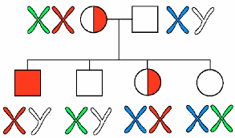
Sex-linked Inheritance
Sex-linked genes are genes that are only present on the sex chromosomes.
Most sex-linked genetic traits in humans are carried on the X chromosome.
When we write sex-linked inheritance, we use the X & Y chromosomes with the allele code.
e.g. X^{N}Y or X^{N}X^{N}

Slide 38
Sex-linked Inheritance – colour-blindness
Colour-blindness is an example of a sex-linked trait
Normal vision (N) is dominant to red-green colour-blindness (n).
So, for females who a heterozygous (X^{N}X^{n}), they still have normal vision.
However, these females are carries for the allele.
A carrier: is a heterozygous female who has the recessive X gene, and can pass it on to the next generation.
The Y chromosome doesn’t carry the colour-blindness gene. Which means the only possible genotypes are X^{N}Y or X^{n}Y.
What does it mean for the X^{n}Y male?

Slide 39
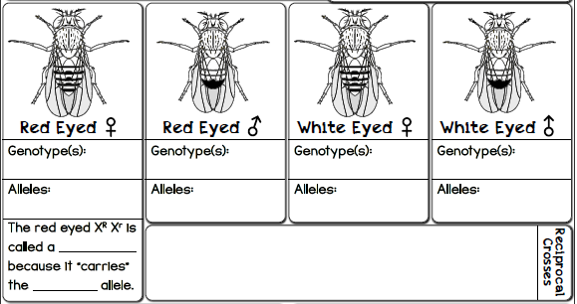

Sex-linked Inheritance – Fruit fly eye-colour
>>
Female
(the girl is “standing up”)
<<
Male
(the boy is “waving around”)
In fruit flies the red eye colour is dominant to the white.
Write out the possible genotypes for the different fly phenotypes.

Slide 40
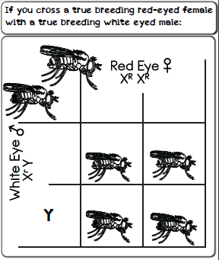
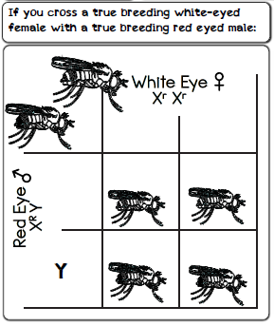
Sex-linked Inheritance – Fruit fly eye-colour
Complete the Punnett Squares for #1 a White eye female, with a Red eye male. And #2 a Red eye female with a white eye male
#2
#1
#2
#1
X^{r}
X^{r}
Carrier female
Affected male
Unaffected male
X^{R}
X^{R}
X^{R}X^{r}
X^{R}X^{r}
X^{R}X^{r}
X^{R}X^{r}
X^{r}
X^{R}
X^{r}Y
X^{r}Y
X^{R}Y
X^{R}Y

Slide 41
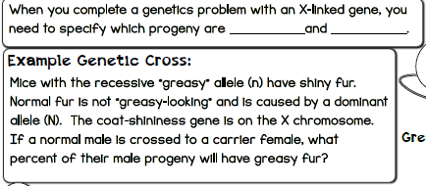
Sex-linked Inheritance – mouse fur
Male
Female

Slide 42
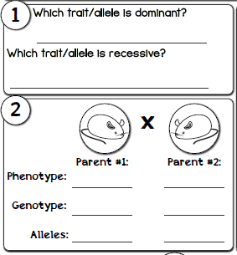


Sex-linked Inheritance – mouse fur
Complete the Punnett square for this cross
Which trait/allele is dominant?
Non-greasy fur (N)
Which trait/allele is recessive?
Greasy fur (n)
X^{N}
X^{n}
X^{N}
X^{N}X^{N}
X^{N}X^{n}
Pheno
Non-greasy
Non-greasy
Geno
X^{N}Y
X^{N}X^{n}
Y
X^{N}Y
X^{n}Y

Slide 43
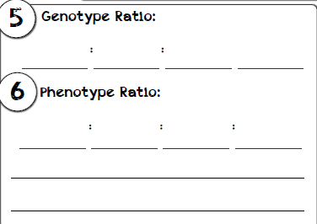
Sex-linked Inheritance – mouse fur
Determine the genotype and phenotype percentages for the offspring
X^{N}X^{N}
X^{N}X^{n}
X^{N}Y
X^{n}Y
Normal female
Carrier female
Normal male
Greasy male
25% of all offspring are greasy
50% of all male offspring are greasy

Slide 44
Sex-linked Inheritance – haemophilia
1. Cross a father who has haemophilia (X^{h}Y) with a mother who doesn’t have haemophilia (X^{H}X^{H}).
Complete a Punnett square and circle any offspring who will have haemophilia.
2. Cross a father who doesn’t have haemophilia with a mother who is heterozygous for the trait.
Complete a Punnett square and circle any offspring who will have haemophilia.

Slide 45
Sex-linked Inheritance – haemophilia
#2
#1
 | X^{H} | X^{H}
X^{h} | X^{H}X^{h} | X^{H}X^{h}
Y | X^{H}Y | X^{H}Y
 | X^{H} | X^{h}
X^{H} | X^{H}X^{H} | X^{H}X^{h}
Y | X^{H}Y | X^{h}Y
NONE!

Slide 46
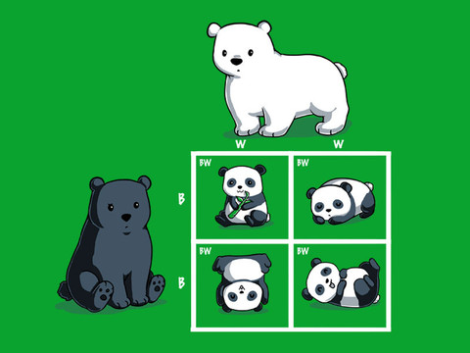
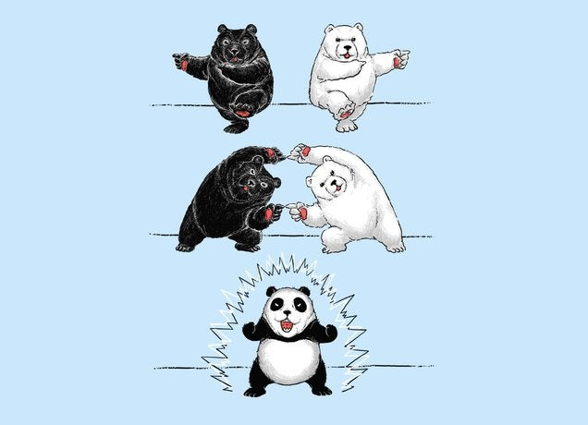
Co-dominance… something for year 11 and 12 Biology…

Slide 47
We are learning about Pedigrees
TRACK WITH ME
READ WITH ME
Recall genetics terminology & symbols
Determine offspring with sex-linked traits.
Analyse inheritance patterns to complete pedigree charts
DECLARE THE OBJECTIVE
Read the learning objective to your partner.
Notes:
Learning Objectives contain concepts (nouns, big ideas), skills (verbs, measurable behaviours) and sometimes context (restricting or targeting conditions).
●Example: Students will be able to describe the concept of density and apply it to floating and sinking.
●
Success criteria are specific measurable outcomes that if met mean that the student has met the learning objective.
Examples:
•Students will be able to compare densities of substances using mass and volume.
•Students will be able to identify whether a solid or liquid will float or sink in a liquid based on their densities.

Slide 48
Pedigrees

Slide 49
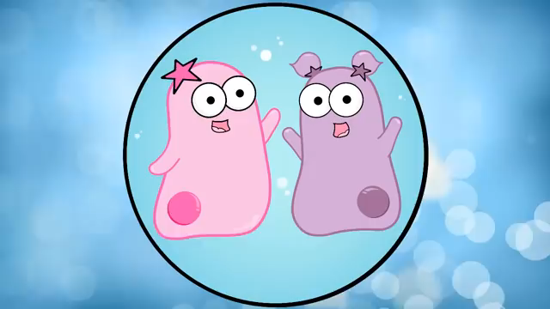

Slide 50
Pedigrees
A pedigree is a diagram used to show pattern of inheritance over generations.
Is used to study the transmission of a
hereditary condition.
Are an ethical way of studying human
genetics.
Can be used for both autosomal and sex-linked
conditions

Slide 51
Pedigree Symbols
Normal male
Affected male
Normal female
Affected female
Marriage
Children
or Carrier
A marriage with five children, two daughters and three sons. The middle son is affected by the condition
Eldest child ↔ Youngest child

Slide 52
Organising Pedigrees
Generations in a pedigree are identified by Roman numerals.
Individuals in each
generation are identified
by Arabic numerals
Numbered from the left.
Therefore, the affected
individuals are II3, IV2
and IV3
I
II
III
IV

Slide 53
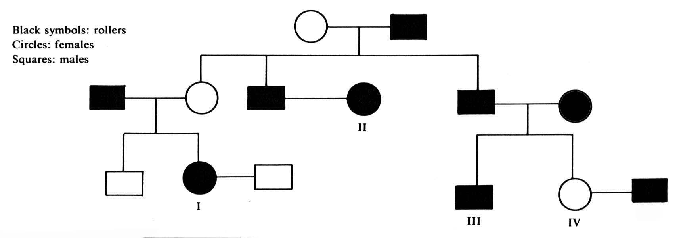
Tongue Rolling
If two affected individuals give rise to an unaffected child, the affected condition is dominant.
So, the roller allele is dominant (R) and the non-roller allele is recessive (r).

Slide 54
Tongue Rolling
Which means all non-rollers must be genotype rr
If one parent is a roller and the other is a non-roller, all the roller children must be heterozygous rollers
If two affected individuals give rise to an unaffected child, the affected condition is dominant.
So, the roller allele is dominant (R) and the non-roller allele is recessive (r).
rr
Rr
?
Rr
rr
Rr
Rr
Rr
?
?
rr
RR or Rr
rr
Rr
rr

Slide 55
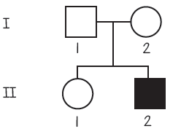
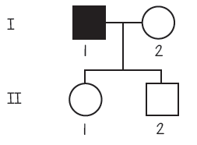
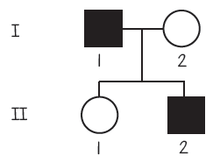
Pedigree practice – autosomal recessive
Using the letters, A and a, look at the below pedigrees and answer the questions.
1
2
3
What is the genotype of I-2? How do you know?
What is the genotype of I-1? How do you know?
What is the genotype of II-2? How do you know?

Slide 56
Pedigree practice – autosomal recessive
Using the letters, A and a, look at the below pedigrees and answer the questions.
1
2
3
Answer: Aa, because one parent must have at least one a
Answer: Aa, because II-1’s parent has aa, so each child has an a
Answer: Aa, II-2 is aa, therefore both parents have an a

Slide 57
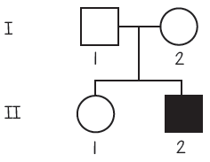
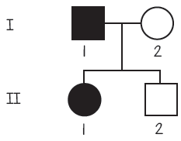
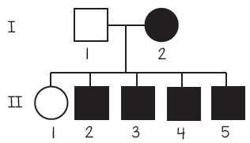
Pedigree practice – sex-linked recessive
Using X^{A}, Xª and Y, look at the below pedigrees and answer the questions.
1
2
3
Q: What is the genotype of I-2? How do you know?
Q: What is the genotype of II-1? How do you know?
Q: Predict the 6th child (boy) phenotype.
Explain your answer.

Slide 58
Pedigree practice – sex-linked recessive
Using X^{A}, Xª and Y, look at the below pedigrees and answer the questions.
1
2
3
A: The mother is XªXª, therefore all sons will be affected.
A: X^{A}Y, I-1 is male and not affected.
A: XªXª, II-1 is female and affected

